Slide 1
STUDENT PORTFOIO
STUDENT NAME:R.SUMATHI
REGISTER NUMBER:24132251802522053
NMID :asanm225anm22524132251802522053
DEPARTMENT: BSC.COMPUTER SCIENCE
COLLEGE: GOVERNMENT ARTS AND SCIENCE COLLEGE VANUR
ANNAMALAI UNIVERSITY(CHITHAMBARAM)

Slide 2
PROJECT TITLE A CREATIVE STUDENT PORTFOLIO USING FWD

Slide 3


AGENDA
Problem Statement
Project Overview
End Users
Tools and Technologies
Portfolio design and Layout
Features and Functionality
Results and Screenshots
Conclusion
Github Link
3/21/2024 Annual Review

Slide 4

PROBLEM STATEMENT
“Students do not have a proper platform to display their skills,
projects, and achievements in an organized way, which makes it
difficult to showcase their talents effectively.”

Slide 5

PROJECT OVERVIEW
“The Student Portfolio is a digital platform designed to showcase a
student’s personal details, skills, academic achievements, and projects in
an organized and professional way. It helps students present their
talents clearly to teachers, recruiters, and others.”

Slide 6

WHO ARE THE END USERS?
Students – who create and maintain their portfolios.
Teachers / Mentors – who review and guide students.
Recruiters / Companies – who evaluate students for jobs or internships.
Peers / Classmates – who get inspired or collaborate.

Slide 7

TOOLS AND TECHNIQUES
TOOLS: HTML, CSS, JavaScript, VS Code, GitHub, Canva, PowerPoint.
TECHNIQUES: Responsive design, UI/UX principles, proper layout, screenshots, and organized presentation

Slide 8
PORTFOLIO DESIGN AND LAYOUT
Portfolio – A collection of student’s details, skills, achievements, and projects.Layout – The design/structure of the portfolio, including sections like About Me, Skills, Projects, Achievements, and Contact.
8

Slide 9
FEATURES AND FUNCTIONALITY
About Me: sectionSkills & AchievementsAcademic detailsProjects & ScreenshotsContact information
Functionality:Easy navigationResponsive design (mobile & desktop)Organized presentation of detailsDownload/Share option

Slide 10
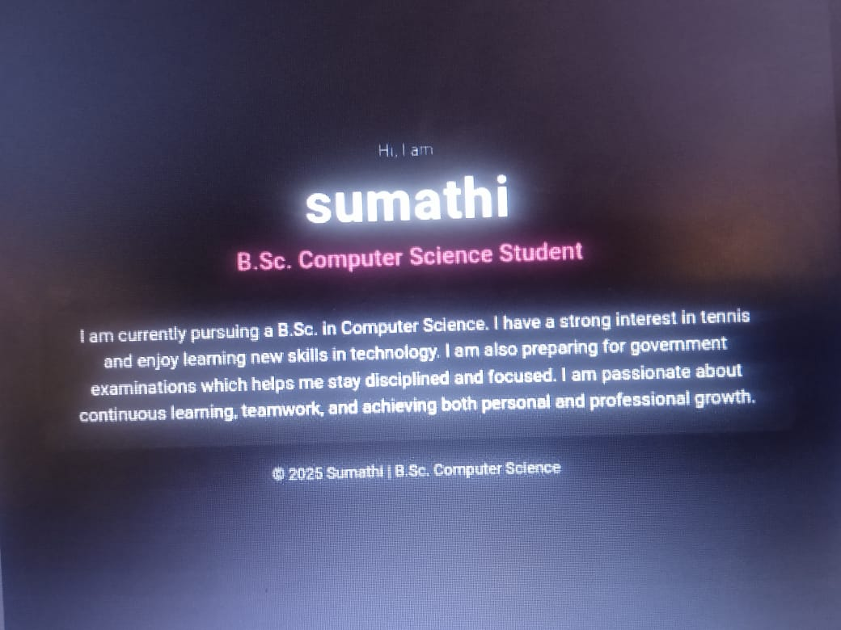

RESULTS AND SCREENSHOTS
3/21/2024 Annual Review
10

Slide 11
GITHUB
https://sumathi200728.github.io/Sumathi-TNSDC--FWD-DP/

Slide 12
CONCLUSION
“A Student Portfolio is an effective way to showcase skills, achievements, and projects in a structured format. It helps students present themselves professionally and creates better opportunities for career and academic growth.”
12

